Slide 1
Data Compression

Slide 2
7.1 Storage Space
Uncompressed graphics, audio, and video data require substantial storage capacity, which is not possible in the case of uncompressed video data, even given today’s CD and DVD technology.
Data transfer of uncompressed video data over digital networks requires that very high bandwidth be provided for a single point-to-point communication.
To be cost-effective and feasible, multimedia systems must use compressed video and audio streams.
The most important compression techniques in use today are
JPEG for single pictures
H.263 (p×64) for video
MPEG for video and audio
as well as proprietary techniques such as QuickTime from Apple and Video for Windows from Microsoft.

Slide 3

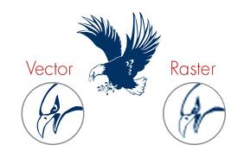

Slide 4
Coding Requirements
The following specification are based on
A small window of 640x 480 pixels on a display
1Kbit = 1024bit
1Mbit = 1024×1024bit
For the representation of the text medium, two bytes are used for every 8×8 pixel character.
Character per screen page =( 640x480)/8x8=4,800
Storage required per screen page =4,800x2bytes=9,600 byte.

Slide 5
2. For the representation of vector images, we assume that a typical image consists of 500 lines . Each line is defined by its coordinates in the x direction and the y direction, and by an 8-bit attribute field. Coordinates in the x direction require 10 bits (log ₂ (640)), while coordinates in the y direction require 9 bits (log 2 (480)).
Bits per line = 9bits + 10bits + 9bits + 10bits + 8bits = 46bits
Storage required per screen page = 500x(46/8)= 2,875 byte
= 2.8Kbyte
3. Individual pixels of a bitmap can be coded using 256 different colours, requiring a single byte per pixel.
Storage required per screen page =640×480×1byte =307,200 byte = 300Kbyte

Slide 6
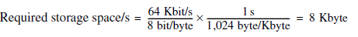
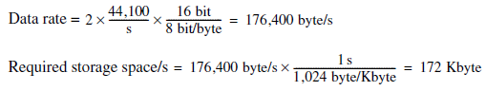
Examples specify continuous media
Derive the storage required for one second of playback
Uncompressed speech of telephone quality is sampled at 8kHz and quantized using 8bit per sample, yielding a data stream of 64Kbit/s.
2. An uncompressed stereo audio signal of CD quality is sampled at 44.1kHZ and quantized using 16 bits.

Slide 7
A video sequence consists of 25 full frames per second.
The luminance [represents the brightness in an image] and chrominance [represent the color information] of each pixel are coded using a total of 3 bytes.
According to CCIR 601 (studio standard for digital video), the luminance (Y) is sampled at 13.5MHz, while chrominance (R–Y and B–Y) is sampled using 6.75MHz. Samples are coded uniformly using 8bits.
Bandwidth = (13.5 MHz + 6.75 MHz + 6.75 MHz)×8bit =216×10⁶
bit/s.
Data rate=640 × 480 × 25 × 3 byte/s = 23,040,000 byte/s
High-resolution television uses twice as many lines and an aspect ratio of 16:9,yielding a data rate 5.33 times that of current televisions.

Slide 8
Requirements of Dialog and Retrieval mode applications
“dialogue” mode applications :e.g. video conferencing or picture transmission.[interaction among user via multimedia information]
“retrieval” mode applications: e.g. audiovisual information systems, where a human user retrieves information from a multimedia database.
The following used for “dialogue” mode applications requirement applies to compression techniques :
The end-to-end delay should not exceed 150ms for compression and decompression alone.
To support an easy, natural dialogue, ideally compression or decompression by itself should introduce an additional delay of no more than 50ms.
The overall end-to-end delay additionally comprises delay in the network, communications protocol processing in the end system, and data transfer to and from the respective input and output devices.

Slide 9
The following requirements apply to compression techniques used for “Retrieval” mode applications:
Fast forward and fast rewind with simultaneous display (or playback) of the data should be possible, so that individual passages can be sought and found quicker.
Random access to single images or audio passages in a data stream should be possible in less than half a second.
Decompression of images, video, or audio passages should be possible without interpreting all preceding data. This allows random access and editing.

Slide 10
The following requirements apply to compression techniques used for either dialogue or retrie val mode applications:
To support display of the same data in different systems, it is necessary to define a format that is independent of frame size and video frame rate.
Audio and video compression should support different data rates (at different quality) so that the data rate can be adjusted to specific system conditions.
It should be possible to precisely synchronize audio and video. a system program should synchronize with other media.
It should be possible to implement an economical solution today either in software or using at most a few VLSI chips.
The technique should enable cooperation among different systems. It should be possible for data generated on a local multimedia system to be reproduced on other systems.

Slide 11
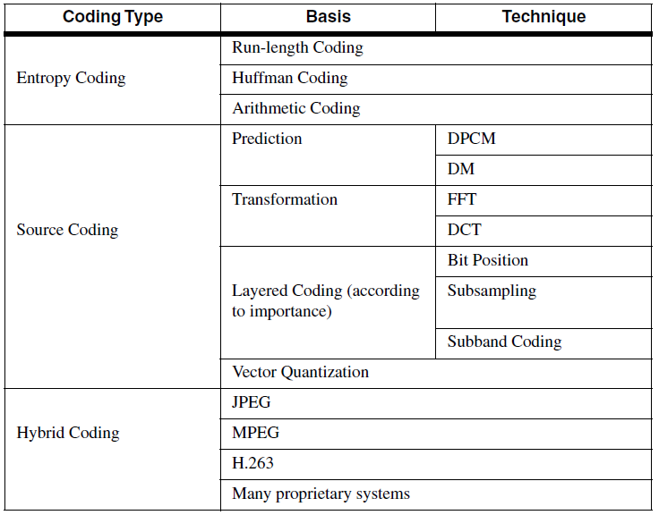

Slide 12
Types of coding
Entropy
Source
Hybrid Coding
Entropy
Entropy coding can be used for different media regardless of the medium’s specific characteristics.
The data to be compressed are viewed as a sequence of digital data values, and their semantics are ignored.
It is lossless because the data prior to encoding is identical to the data after decoding; no information is lost.
Thus run-length encoding can be used for data like text, still images for facsimile, or as part of motion picture or audio coding.

Slide 13
Source coding
It is a lossy process.
It considers, the semantics of the information to be encoded.
The degree of compression depends on the medium.
In the case of lossy compression, a relation exists between the uncoded data and the decoded data; the data streams are similar but not identical.
The characteristics of the medium can be exploited.
FOR EXAMPLE:
In the case of speech, a considerable reduction of the amount of data can be achieved by transforming the time-dependent signal into the frequency domain, followed by an encoding of the formants.
In the case of still images, spatial redundancies can be used for compression through a content prediction technique.
Other techniques perform a transformation of the spatial domain into the two-dimensional frequency domain by using the cosine transform. Low frequencies define the average color, and the information of higher frequencies contains the sharp edges. Hence, low frequencies are much more important than the higher frequencies, a feature that can be used for compression.

Slide 14
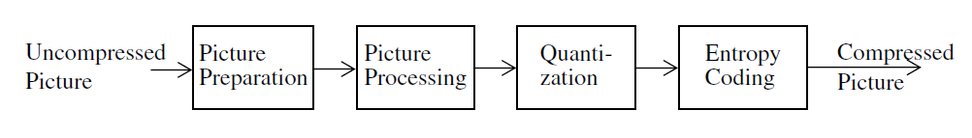
Major Steps of Data Compression
Above figure shows the typical sequence of operations performed in the compression of still images and video and audio data streams. we consider these a set of typical processing steps common to all techniques (entropy, source, and hybrid).

Slide 15
The following example describes the compression of one image:
The preparation step (here picture preparation) generates an appropriate digital representation of the information in the medium being compressed. For example, a picture might be divided into blocks of 8×8 pixels with a fixed number of bits per pixel.
The processing step (here picture processing) is the first step that makes use of the various compression algorithms. For example, a transformation from the time domain to the frequency domain can be performed using the Discrete Cosine Transform (DCT). In the case of interframe coding, motion vectors can be determined here for each 8×8 pixel block.
Quantization takes place after the mathematically exact picture processing step. Values determined in the previous step cannot and should not be processed with full exactness; instead they are quantized according to a specific resolution and characteristic curve. This can also be considered equivalent to the μ -law and A law, which are used for audio data. In the transformed domain, the results can be treated differently depending on their importance (e.g., quantized with different numbers of bits).

Slide 16
Entropy coding starts with a sequential data stream of individual bits and bytes. Different techniques can be used here to perform a final, lossless compression. For example, frequently occurring long sequences of zeroes can be compressed by specifying the number of occurrences followed by the zero itself.
Decompression is the inverse process of compression. Specific coders and decoders can be implemented very differently.
Symmetric coding is characterized by comparable costs for encoding and decoding, which is especially desirable for dialogue applications.
In an asymmetric technique, the decoding process is considerably less costly than the coding process. This is intended for applications where compression is performed once and decompression takes place very frequently, or if the decompression must take place very quickly. For example, an audio-visual course module is produced once, but subsequently decoded by the many students who use it. The main requirement is real-time decompression.
An asymmetric technique can be used to increase the quality of the compressed images.

Slide 17
Basic Compression Techniques
Run-Length Coding:
Uncompressed data: ABCCCCCCCCDEFGGG
Run-length coded: ABC!4DEFGGG
Zero Suppression
Run length coding is a generalization of Zero Suppression, which assume that just one symbol appears particularly often in sequence.
The blank(space) character in text is such a symbol; single or pair of blank are ignored.
Starting with sequences of three bytes, they are replaced by an M-byte and a byte specifying the number blanks in the sequence.
The number of occurrences can again be offset(by -3).
Sequence of between three and 257 bytes can thus be reduced to two bytes.

Slide 18
Vector quantization
A data stream is divided into blocks of n bytes each(n>1).
A predefined table contains a set of patterns.
For each block, the table is consulted to find the most similar pattern.
Each pattern in the table is associated with an index.
Thus block can be assigned an index, The index will be a vector.
The corresponding decoder has the same table and uses the vector to generate an approximation of the original data stream.

Slide 19
Pattern Substitution
This technique used for text compression, substitutes single bytes for patterns that occur frequently.
This pattern substitution can be used to code, for example,the terminal symbols of high-level languages (begin, end, if).
By using an M-byte, a larger number of words can be encoded–the M-byte indicates that the next byte is an index representing one of 256 words.
The same technique can be applied to still images, video, and audio. In these media, it is not easy to identify small sets of frequently occurring patterns. It is thus better to perform an approximation that looks for the most similar (instead of the same) pattern. This is the above described vector quantization.

Slide 20
Diatomic Encoding
Diatomic encoding is a variation based on combinations of two data bytes.
This technique determines the most frequently occurring pairs of bytes.
Studies have shown that the eight most frequently occurring pairs in the English language are “E,” “T,” “TH,” “A,” “S,” “RE,” “IN,” and “HE.”
Replacing these pairs by special single bytes.
This leads to a data reduction of more than ten percent.
Statistical Coding
There is no fundamental reason that different characters need to be coded with a fixed number of bits.
Morse code is based on this: frequently occurring characters are coded with short strings, while seldom-occurring characters are coded with longer strings. Such statistical coding depends how frequently individual characters or sequences of data bytes occur.
There are different techniques based on such statistical criteria, the most prominent of which are Huffman coding and arithmetic coding.

Slide 21
Huffman Coding
Characters that must be encoded, together with their probabilities of Occurrence are given, the Huffman coding algorithm determines the optimal coding using the minimum number of bits.
The length (number of bits) of the coded characters will differ. The most frequently occurring characters are assigned to the shortest code words.
A Huffman code can be determined by successively constructing a binary tree, whereby the leaves represent the characters that are to be encoded.
Every node contains the relative probability of occurrence of the characters belonging to the sub tree beneath the node.
The edges are labelled with the bits 0 and 1.

Slide 22
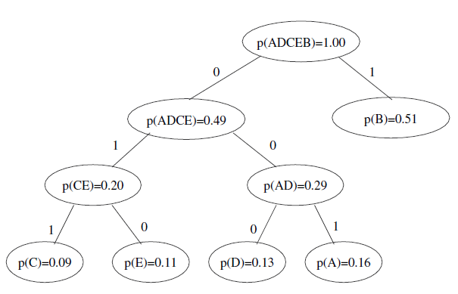
Example:
The letters A, B, C, D, and E are to be encoded and have relative probabilities of occurrence as follows:
p(A)=0.16, p(B)=0.51, p(C)=0.09, p(D)=0.13, p(E)=0.11
w(A)=001, w(B)=1, w(C)=011, w(D)=000, w(E)=010

Slide 23
Example 2
Symbol Frequency
A 24
B 12
C 10
D 8
E 8 ----> total 186 bit (with 3 bit per code word)

Slide 24
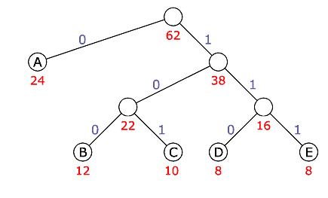

Slide 25
Symbol Frequency Code Code Length total Length
A 24 0 1 24
B 12 100 3 36
C 10 101 3 30
D 8 110 3 24
E 8 111 3 24
----------------------------------------------------------------------------------------------------
tot. 138 bit (3 bit code)

Slide 26
The result is the following code words, which are stored in a table:
w(A)=001, w(B)=1, w(C)=011, w(D)=000, w(E)=010
Such a table could be generated for a single image or for multiple images together.
In the case of motion pictures, a Huffman table can be generated for each sequence or for a set of sequences. The same table must be available for both encoding and decoding.
If the information of an image can be transformed into a bit stream, then a Huffman table can be used to compress the data without any loss.
The simplest way to generate such a bit stream is to code the pixels individually and read them line by line.For example run length encoding.

Slide 27
Arithmetic Coding
Arithmetic coding is optimal from an information theoretical point of view. Therefore, the length of the encoded data is also minimal.
Unlike Huffman coding, arithmetic coding does not code each symbol separately. Each symbol is instead coded by considering all prior data.
When a string is converted to arithmetic encoding, frequently used characters will be stored with fewer bits and not-so-frequently occurring characters will be stored with more bits, resulting in fewer bits used in total.
Arithmetic coding encodes the entire message into a single number
In practice, the average compression rates achieved by arithmetic and Huffman coding are similar.
Differences in compression efficiency arise in special cases, for example in digitized graphics consisting primarily of a single (background) color. Arithmetic coding is better suited than Huffman coding in this case.
If symbols occur in the input data stream with such a frequency that they have a very small information content. These can be encoded using less than one bit, whereas in Huffman coding each symbol requires at least one bit.

Slide 28
Transformation Coding
Data is transformed into another mathematical domain that is more suitable for compression. An inverse transformation must exist.
The simplest example is the Fourier transform, which transforms data from the time domain into the frequency domain.
Other examples include the Walsh, Hadamard, Haar, and Slant transforms.
The most effective transformations for data reduction are the
Discrete Cosine Transform (DCT),
The Fast Fourier Transform (FFT).

Slide 29
Subband Coding
Selective frequency transformation (subband coding) considers the signal only in predefined regions of the spectrum, such as frequency bands.
The number of bands is a crucial quality criterion.
This technique is well suited for the compression of speech.
Prediction or Relative Coding
Instead of compressing single bytes or sequences of bytes, differential encoding can be used. This is also known as prediction or relative coding.
For example, if characters in a sequence are clearly different from zero, but do not differ much amongst themselves, then calculating differences from the respective previous value could be profitable for compression.
Examples in different media:
For still images, edges yield large difference values, while areas with similar luminance and chrominance yield small values. A homogeneous area is characterized by a large number of zeroes, which could be further compressed using run-length coding.

Slide 30
For video, performing relative coding in the time domain leads to an encoding of differences from the previous image only.
Audio techniques often apply Differential Pulse Code Modulation (DPCM) to a sequence of PCM-coded samples. This technique requires a linear characteristic curve for quantization. It is thus not necessary to store the whole number of bits for each sample. It is sufficient to represent the first PCM-coded sample as a whole and all following samples as the difference from the previous one.
Delta Modulation
Delta Modulation is a modification of DPCM where difference values are encoded with exactly one bit, which indicates whether the signal increases or decreases.
This technique is particularly profitable if the coding does not depend on 8-bit grid units.
If the differences are small, then a much smaller number of bits is sufficient. Difference encoding is an important feature of all techniques used in multimedia systems.

Slide 31
Other Basic Techniques
Video compression techniques often use Color Look-Up Tables This technique is used in distributed multimedia systems.
A simple technique for audio is silence suppression, whereby data is only encoded if the volume exceeds a certain threshold.
ITU incorporates some of the basic audio coding techniques in the G.700 series of standards: G.721 defines PCM coding for 3.4kHz quality over 64Kbit/s channels, and G.728 defines 3.4kHz quality over 16Kbit/s channels

Slide 32
JPEG(Joint Photographic Experts Group)
The coding known as JPEG (Joint Photographic Experts Group) is a joint project of ISO/IECJTC1/SC2/WG10 and Commission Q.16 of CCITT SGVIII. Hence the “J” (from “Joint”) in JPEG—ISO together with CCITT.
In 1992, JPEG became an ISO International Standard (ISO)
JPEG applies to color and gray-scaled still images ,Video sequences can also be handled through a fast coding and decoding of still images, a technique known as Motion JPEG.
Implementations of parts of JPEG are already available, either as software-only packages or using special-purpose hardware support.

Slide 33


Slide 34
Requirements
The standard should be independent of image size.
It should be applicable to any image aspect ratio and any pixel aspect ratio.
The color space and the number of colors used should be independent of one another.
Image content may be of any complexity, with any statistical characteristics.
The JPEG standard should be start-of-the-art (or near) regarding the compression factor and image quality.
The processing complexity should permit a software solution to run on a large number of available general-purpose processors, and should be drastically reduced with the use of special-purpose hardware.
Sequential (line by line) and progressive (successive refinement of the whole image) decoding should both be possible. A lossless, hierarchical coding of the same image with different resolutions should also be possible. The user can select parameters to trade off the quality of the reproduced image, the compression processing time, and the size of the compressed image.

Slide 35
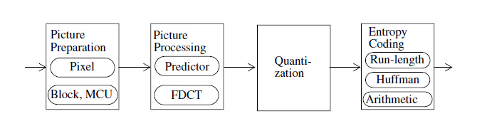
Steps of the JPEG compression technique
Fig : Steps of the JPEG compression technique

Slide 36
JPEG Modes
The lossy, sequential DCT-based mode (baseline process, base mode) must be supported by every JPEG decoder.
The expanded lossy, DCT-based mode provides a set of further enhancements to the base mode.
The lossless mode has a low compression ratio and allows a perfect reconstruction of the original image.
The hierarchical mode accommodates images of different resolutions by using algorithms defined for the other three modes.

Slide 37
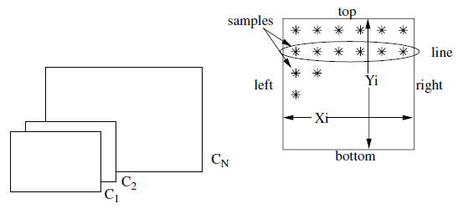
Image Preparation
JPEG specifies a very general image model that can describe most commonly used still image representations.
An image consists of at least one and at most N=255 components or planes, as shown on the left side of below figure. These planes can be assigned to individual RGB (red, green, blue) colors, or to the YIQ or YUV signals, for example.
Each component is a rectangular array X_{i} x Y_{i} of pixels(samples).

Slide 38
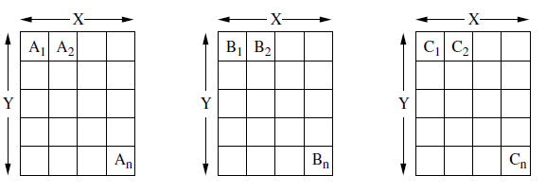
Example of JPEG image preparation with three components having the same resolution.

Slide 39
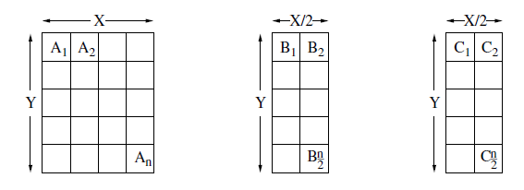
Example of JPEG image preparation with three components having different resolutions.

Slide 40
A gray-scale image will consist of a single component, while an RGB color image will have three components with the same resolution (same number of lines Y₁ = Y₂ = Y₃ and the same number of columns X₁ = X₂ = X₃).
YUV color images with sub sampling of the chrominance components use three planes with Y₁ = 4Y₂ = 4Y₃ and X₁ = 4X₂ = 4X₃.
Each pixel is represented by p bits with values in the range from 0 to 2^{p–1}. All pixels of all components of an image must have the same number of bits.
The lossy modes of JPEG use a precision of either 8 or 12 bits per pixel.
The lossless modes can use between 2 and 12 bits per pixel.
If a JPEG application uses any other number of bits, the application itself must suitably transform the image to conform to the number of bits defined by the JPEG standard.

Slide 41
Instead of the values X_{i} and Y_{i} , the compressed data includes the values X (maximum of all Xi) and Y (maximum of all Yi), as well as factors Hi and Vi for each plane.
Hi and Vi represent the relative horizontal and vertical resolutions with respect to the minimal horizontal and vertical resolutions.
For example
An image has a maximum resolution of 512 pixels in both the horizontal and vertical directions and consists of three planes.
Plane 0: H₀ = 4, V₀ = 1
Plane 1: H₁ = 2, V₁ = 2
Plane 2: H₂ = 1, V₂ = 1
This leads to: X = 512, Y = 512, H_{max} = 4 and V_{max} = 2
Plane 0: X₀ = 512, Y₀ = 256
Plane 1: X₁ = 256, Y₁ = 512
Plane 2: X₂ = 128, Y₂ = 256

Slide 42
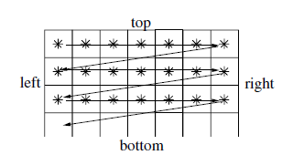
In the image preparation stage, the image is divided into data units.
The lossless mode uses one pixel as one data unit.
The lossy mode uses blocks of 8x8 pixels.
The units are processed from left to right with in each component. This is known as a non-interleaved data ordering.
If the non-interleaved mode were used for a very high resolution, RGB-encoded image, during the display would first show only red, then red-green and finally the correct colors.

Slide 43
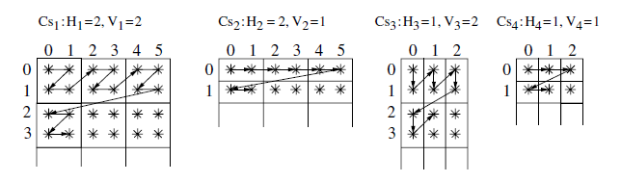
Fig. Interleaved processing order of data units.
The arrows with in each component indicate the sampling order of individual data units.
In JPEG encoding the data is broken into a number of blocks called Minimum Coded Units (MCU’s).

Slide 44
The arrows with in each component indicate the sampling order of individual data units.
In JPEG encoding the data is broken into a number of blocks called Minimum Coded Units (MCU’s).
Interleaved data units of different components are combined into Minimum coded units.
Minimum Coded Units (MCU’s) are built in the following order.
MCU₁ =d¹₀₀ d¹₀₁ d¹₁₀ d¹₁₁ d²₀₀ d²₀₁ d³₀₀ d³₁₀ d⁴₀₀
MCU₂ =d¹₀₂ d¹₀₃ d¹₁₂ d¹₁₃d²₀₂ d²₀₃ d³₀₁ d³₁₁ d⁴₀₁
MCU₃ =d¹₀₄ d¹₀₅ d¹₁₄ d¹₁₅d²₀₄ d²₀₅ d³₀₂ d³₁₂ d⁴₀₂
MCU₄ =d¹₂₀ d¹₂₁ d¹₃₀ d¹₃₁d²₁₀ d²₁₁ d³₂₀ d³₃₀ d⁴₁₀

Slide 45
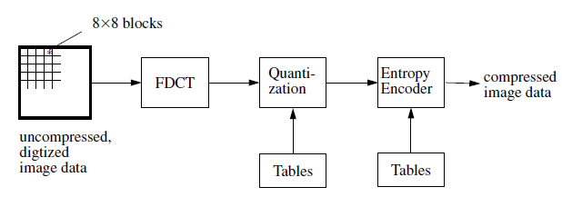
Lossy Sequential DCT-Based Mode(baseline process, base mode)
Image processing
In this baseline mode, blocks of 8x8 pixels come to the image processing unit in particular order from the previous step.
Each pixel is encoded using 8 bits.
First step of image processing is a transformation performed by DCT.
Fig. Steps of the lossy sequential DCT-based coding mode, starting with an uncompressed image after image preparation.

Slide 46
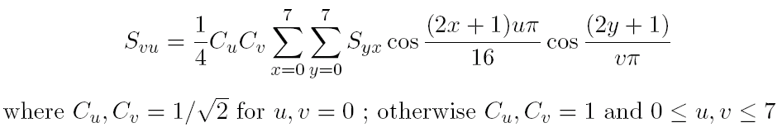
At the beginning of FDCT, the pixel values are shifted into the range [-128, 127], with zero as the center. These shifted pixel values are the Syx, used in the formula.
FDCT:
FDCT transforms an image from spatial to frequency domain.
Transforming a 8x8 pixel block through FDCT we find 64 coefficients which can be regarded as a two-dimensional frequency.
The formula for FDCT is given below
S_{vu} represents the DCT coefficients.
The co-efficient S₀₀ corresponds to the lowest frequency in both dimensions. It is known as DC-coefficient, which determines the fundamental color of the data units of 64 pixels.
The other coefficients are called AC-coefficients.

Slide 47
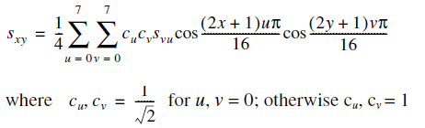
For later reconstruction of the image, the decoder uses the Inverse DCT (IDCT).The coefficients S_{vu} must be used for the calculation:
If the FDCT, as well as the IDCT, could be calculated with full precision, it would be possible to reproduce the original 64 pixels exactly
From a theoretical point of view, DCT would be lossless in this case.
In practice, precision is limited and DCT is thus lossy. The JPEG standard does not define any specific precision.

Slide 48
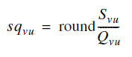
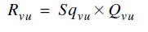
Quantization
Image processing is followed by the quantization of all DCT coefficients; this is a lossy process.
For this step, the JPEG application provides a table with 64 entries, one for each of the 64 DCT coefficients. This allows each of the 64 coefficients to be adjusted separately.
The table entries Q_{vu} are integer values coded with 8 bits. Quantization is performed according to the formula:
This is done by simply dividing each coefficient by a constant for that component, and then rounding to the nearest integer.
Dequantization is performed prior to the IDCT according to the formula:

Slide 49
Entropy Encoding
The DC-coefficients determine the fundamental color of the data units.
During the initial step of entropy encoding, a DC-coefficient is encoded as the difference between the current and the previous one.
Only the differences are subsequently processed.
DC_{i}
DC_{i-1}
Block_{i-1}
Block_{i}
Diff = DC_{i} – DC_{i-1}

Slide 50
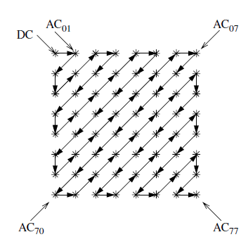
The DCT processing order of the AC-coefficients using the zig-zag sequence as shown in Figure 7-14.
The Zig-Zag sequence actually collects the low frequency coefficients before high frequency coefficients, thereby grouping large numbers at the beginning of the sequence.
The result is an extended sequence of similar data bytes, permitting efficient entropy encoding.

Slide 51
JPEG uses Huffman coding and arithmetic coding as entropy encoding methods.
For the lossy sequential DCT-based base mode, discussed in this section, only Huffman encoding is allowed.
In both methods, a run-length encoding of zero values is first applied to the quantized AC-coefficients. Additionally, non-zero AC-coefficients as well as the DC-coefficients are transformed into a spectral representation to further compress the data.
The number of bits required depends on the value of each coefficient.
Non-zero AC-coefficients are represented using between 1 and 10 bits.
For the representation of DC-coefficients, a higher resolution of 1 bit to a maximum of 11 bits is used.
The result is a representation according to the ISO Intermediate Symbol Sequence Format, which basically alternates the following three pieces of information:
1. the number of subsequent coefficients with the value zero,
2. the number of bits used for the representation of the coefficient that follows, and
3. the value of the coefficient, represented using the specified number of bits.

Slide 52
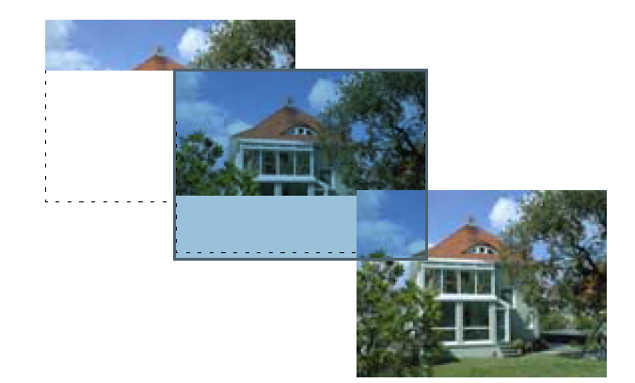
In this case of lossy sequential encoding, the whole image is coded and decoded in a single run.
The figure below shows an example of decoding with immediate presentation; the picture is presented from top to bottom.
Fig. Example of sequential picture preparation, here using the lossy DCTbased mode.

Slide 53
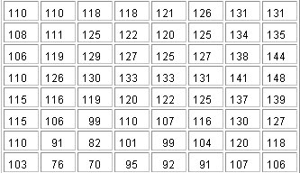
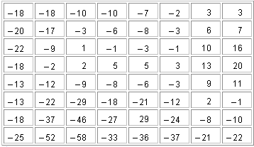
After Level Shifting
A Sample 8 × 8 Data Block

Slide 54
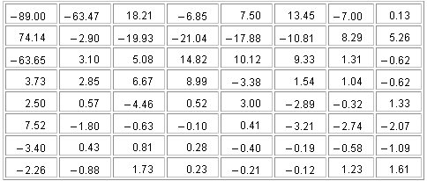
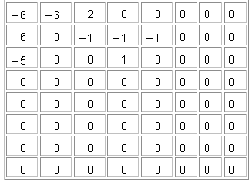
Results of DCT Coefficients
Quantized by Luminance
Quantization Matrix
DCT Coefficients of the Above 8 × 8 Block

Slide 55
The Zig-Zag Sequence to be coded is
−6 6 −5 0 2 0 −1 0 0 0 0 0 −1 0 0 −1 1 0 0 0 0 0 0 0 0 0 0 0 0 0 0 0 0 0 0 0 0 0 0 0 0 0 0 0 0 0 0 0 0 0 0 0 0 0 0 0 0 0 0 0 0 0 0
And the code is
(0, 3)(−6), (0, 3)(6), (0, 3)(−5), (1, 2)(2), (1, 1)(−1), (5, 1)(−1), (2, 1)(−1), (0, 1)(1), (0,0).

Slide 56
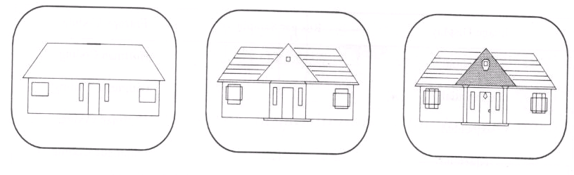
Expanded Lossy DCT-Based Mode
Image Preparation:
The difference in this step from the previous mode is, a sample precision of 12 bits per sample, in addition to 8 bits per sample, can be used.
Image processing:
Image Processing is DCT-based and follows rules analogous to be baseline DCT mode.
Quantization and Encoding:
In this mode, JPEG specifies progressive encoding in addition to sequential encoding.
In the first run, a very rough representation of the image appears which looks out of focus and is refined during successive steps.
Fig: Progressive picture presentation used in the expanded DCT-based mode

Slide 57

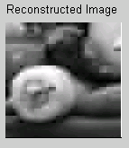
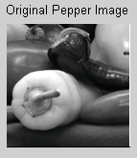
Progressive image representation is achieved by expansion of quantization.
A buffer is added at the output of the quantizer that temporarily stores all coefficients of the quantized DCT.
Progressiveness is achieved in two different ways
By using a spectral selection. DC component and first few AC coefficients are sent first, then gradually some more AC components.
In successive approximation, all of the quantized coefficients are transferred in each run, but individual bits are differentiated according to their significance. The most significant bits are encoded before the least significant bits.
After sending
1 AC coefficient
2nd AC coefficient

Slide 58
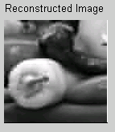
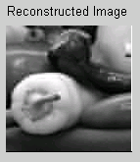
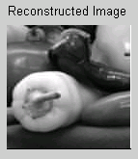
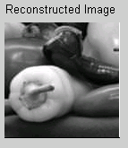
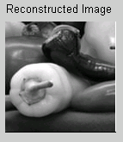
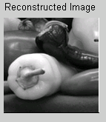
After sending
3rd-5th AC coeff.
6th -9th AC coeff.
10th -15th AC coeff.
16th -20th AC coeff.
20th -30th AC coeff.
30th -40th AC coeff.

Slide 59
Successive approximation:
In this way all the coefficients are sent in each run but single bits are differentiated according to their significance. The MSB bits are encoded first and then the LSB.
For example, To encode the coefficient 13(1101), 8(1000) is encoded in the first run, 4(100) is encoded in the second run, 0(00) is encoded in the third run and 1(1) is encoded in the fourth run.
So, the picture is refined gradually.
So, image display in this mode may be sequential or Progressive, bits per sample may be 8 or 12 and Entropy coding may be Huffman or arithmetic.
Arithmetic entropy coding can be used in expanded mode.
Arithmetic coding automatically adapts itself to the statistical characteristics of an image and thus requires no tables from the application.
This leads to 12 alternative processing modes.

Slide 60
Image Display | Bits Per Sample | Entropy Encoding
Sequential | 8 | Huffman Coding
Sequential | 8 | Arithmetic Coding
Sequential | 12 | Huffman Coding
Sequential | 12 | Arithmetic Coding
Progressive Successive | 8 | Huffman Coding
Progressive Spectral | 8 | Huffman Coding
Progressive Successive | 8 | Arithmetic Coding
Progressive Spectral | 8 | Arithmetic Coding
Progressive Successive | 12 | Huffman Coding
Progressive Spectral | 12 | Huffman Coding
Progressive Successive | 12 | Arithmetic Coding
Progressive Spectral | 12 | Arithmetic Coding

Slide 61
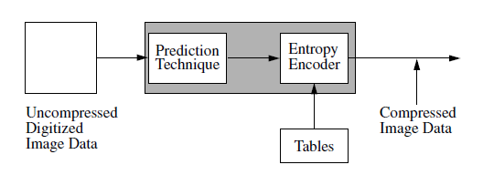
Lossless Mode
Fig. Lossless mode, based on prediction.

Slide 62
Data units of single pixels are taken for image preparation.
Any precision between 2 and 16 bits per pixel can be used
Image processing and quantization use a predictive technique.
For each pixel X, one of eight possible predictions is selected. The selection criterion is a prediction that is as good as possible.
Selection Value | Prediction
0 | No Prediction
1 | X=A
2 | X=B
3 | X=C
4 | X=A+B-C
5 | X=A+(B+C)/2
6 | X=B+(A-C)/2
7 | X=(A+B)/2
 | C | B
 | A | X
Fig. Basis of prediction in lossless mode.
Table. Predictors for lossless coding

Slide 63
Entropy encoding
The number of the chosen predictor, as well as the difference of the prediction to the actual value is passed to the entropy encoding step.
Entropy encoding can use Huffman or arithmetic encoding techniques.

Slide 64
Hierarchical mode
The hierarchical mode uses either the lossy DCT-based algorithms or the lossless compression. The main feature of this mode is the encoding of an image at different resolutions.
The prepared image is initially sampled at a lower resolution (down sampled by 2^{n} ).
That smaller image is coded using another JPEG mode (Progressive, Sequential, or Lossless).
Then the image is decoded and up-sampled.
The difference between the up-sampled and the original image is encoded using Progressive, Sequential, or Lossless
This process can be repeated multiple times. Good for viewing high resolution image on low resolution display.

Slide 65
Advantages
Hierarchical coding is computationally intensive and requires considerable storage space. The advantage is the compressed image is available at different resolutions.
Applications working with lower resolutions thus do not need to first decode the whole image and then reduce the resolution. In other words, scaling becomes cheap.
It is often more efficient to display an image in its full resolution than to first scale it down and display a smaller image.
In the case of images encoded according to the hierarchical JPEG mode, the display of a reduced size picture requires less time to process than one of higher resolution.

Slide 66
H.261 (p×64) and H.263
ISDN [Integrated Services Digital Network] is (and was) behind H.261
A circuit-switched telephone network system, designed to allow digital transmission of voice and data over ordinary telephone copper wires.
In ISDN, there are two types of channels, B (for "Bearer") and D (for "Delta"). B channels are used for data (which may include voice), and D channels are intended for signaling and control (but can also be used for data).
In a narrow-band ISDN connection, exactly two B-channels and one D-channel is available
One or both B channels can transfer video data, in addition to speech.
This requires that both ends have to use the same video data coding schemes

Slide 67
H.261 (p×64) and H.263 cont....
The primary applications of ISDN were video phones and video conferencing.
Such dialogue applications require that coding and decoding being carried out in real-time.
In 1984, Study group XV of CCITT formed a committee to draw up a video standard for compressing moving pictures.
The standard, H.261 ‘Video CoDec for Audiovisual services at p×64Kbit/s” was finalized after 5 years and got accepted in December 1990.
North America adopted it with slight modifications
Since data rates of p×64 Kbit/s are considered, the recommendation was also known as p×64.
Maximum combined signal delay is 150 ms

Slide 68
H.261 (p×64) and H.263 cont....
In this context, codec (Coder/Decoder) refers to encoding and decoding, or to compression and decompression.
The ITU Study Group XV Recommendation H.261 was developed for real-time processing during encoding and decoding.
If the end-to-end delay is too great, the subjective interactivity of a dialogue application using this standard suffers considerably.
H.263 is a provisional ITU-T Standard published in 1996 to replace H.261 for many applications.
H.263 was designed for low bit rate transmission. Early designs called for data rates under 64Kbit/s, though this was later revised.
The H.263 coding algorithm is similar to that of H.261, with some improvements and changes to further improve performance and add error correction.

Slide 69
The following are the key differences between the H.261 and H.263 coding algorithms:
H.263 uses half pixel precision for motion compensation, while H.261 uses full pixel precision with a “loop filter.”
Some parts of the hierarchical structure of the data stream are optional in H.263, so that the codec can be configured for a lower bit rate or better error correction.
H.263 includes four optional, negotiable parameters to improve performance:
• the unrestricted motion vector mode,
• the syntax-based arithmetic coding mode,
• the advanced prediction mode,
• and forward and backward frame prediction (similar to the P and B frames in MPEG).
H.263 can often achieve the same quality as H.261 with less than half as many bits by using the improved negotiable options.
• H.263 supports five resolutions. In addition to QCIF and CIF, which H.261 supports, H.263 also supports SQCIF, 4CIF, and 16CIF. SQCIF has about half the resolution of QCIF. 4CIF and 16CIF correspond to four and 16 times the resolution of CIF, respectively.

Slide 70
Image Preparation
The image refresh frequency(is how many times per second an image is displayed.) at the input must be 29.97frames/s.
During encoding, it is possible to generate a compressed image sequence with a lower frame rate of, for example, 10 or 15 frames per second.
The image is encoded as a luminance signal (Y) and chrominance difference signals C_{b} , C_{r,} according to the CCIR 601 subsampling scheme (2:1:1), which was later adopted by MPEG.
Two resolution formats, each with an aspect ratio(ratio of picture width to picture height) of 4:3 are defined.
1. Common Intermediate Format (CIF) defines a luminance component of 352 lines, each with 288 pixels. As per the 2:1:1 requirement, the chrominance components are sub sampled with 176 lines, each with 144 pixels.
2. Quarter CIF (QCIF) has exactly half the resolution in all components (i.e.,176×144 pixels for the luminance and 88×72 pixels for the other components).
All H.261 implementations must be able to encode and decode QCIF. CIF is optional.

Slide 71
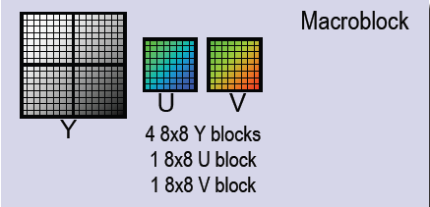
H.261 divides the Y as well as the C_{b} and C_{r} components into blocks of 8×8 pixels.
A macro block is the result of combining four blocks of the Y matrix with one block each from the C_{b} and C_{r} components. A group of blocks consists of 3×11 macro blocks.
A QCIF image thus consists of three groups of blocks and a CIF image consists of twelve groups of blocks.

Slide 72
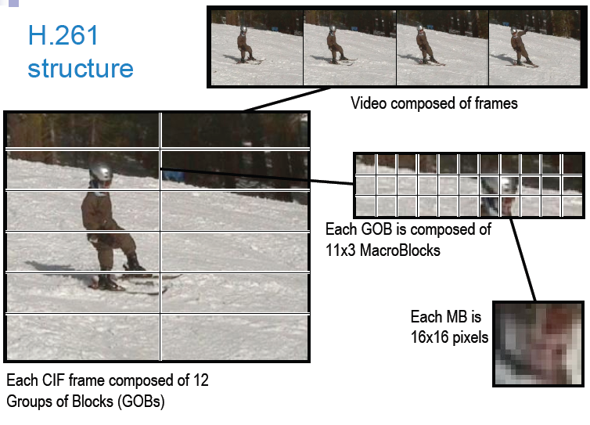

Slide 73
Coding Algorithms
The H.261 standard uses two different methods of coding:
1. Intraframe
2. Interframe.
Intraframe coding considers only the data from the image being coded.
Interframe coding uses data from other images.
H.263, unlike H.261, recommends four negotiable modes of intraframe coding. These can be used separately or together. An exception is that the advanced prediction mode requires use of the unrestricted motion vector mode.

Slide 74
The new intraframe coding modes added to H.263 are
the syntax-based arithmetic coding mode,
defines the use of arithmetic coding instead of variable length coding. This results in identical image recoverability with better compression efficiency.
PB-frame mode
-can increase the frame rate without changing the bit rate by coding two images as one unit.
the unrestricted motion vector mode
-makes it possible for motion vectors to point outside image boundaries.
the advanced prediction mode
-uses the Overlapped Block Motion Compensation(OBMC) technique for p-frame luminance.

Slide 75
Intraframe coding:
Considers data from image being coded
Like JPEG, each block of 8×8 pixels is transformed into 64 coefficients using DCT.
DC coefficients are quantized differently than AC coefficients
Entropy encoding using variable-length code words is then performed.

Slide 76
Interframe coding:
Consider data from other images.
A prediction method is used to find the most similar macro block in the preceding image.
The motion vector is defined by the relative position of the previous macro block with respect to the current macro block.
Next, the motion vector and the DPCM-coded macro block are processed.
The DPCM-coded macro block is transformed by the DCT if and only if its value exceeds a certain threshold value. If the difference is less than the threshold, then the macro block is not encoded any further and only the motion vector is processed.
The components of the motion vector are entropy encoded using variable-length coding. This is lossless.
Transformed coefficients are all quantized linearly and entropy encoded using variable-length code words.
Optionally, an optical low pass filter can be inserted between the DCT and the entropy encoding. This filter deletes any remaining high-frequency noise. H.261 implementations need not incorporate this filter.

Slide 77
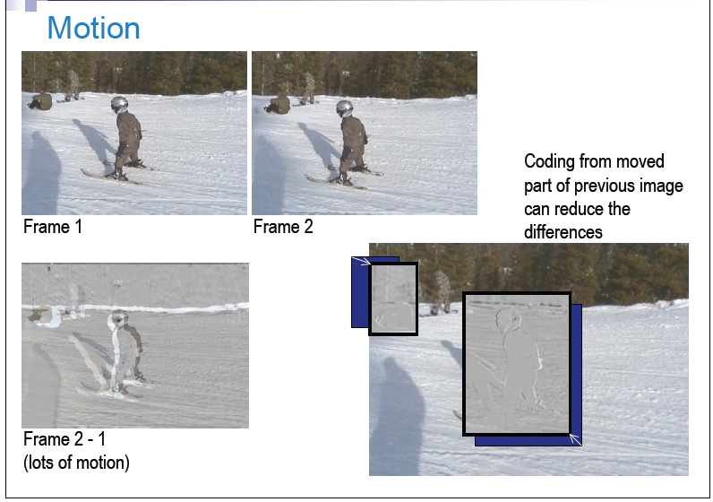

Slide 78
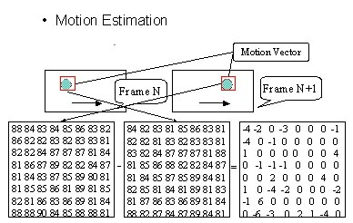

Slide 79
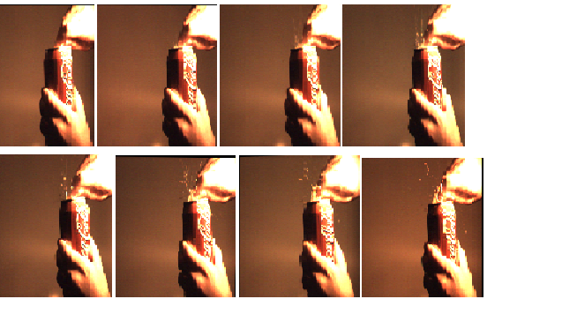

Slide 80
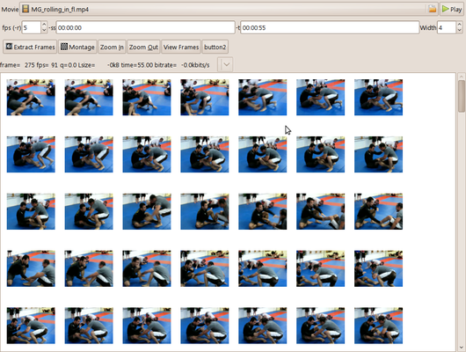

Slide 81
Data Stream
According to H.261/H.263, a data stream is divided into several layers, the bottom layer containing the compressed images.
Properties of H.261 and H.263 are:
The data stream contains information for error correction, although use of external error correction, e.g. H.223, is recommended.
Each image in H.261 includes a five-bit number that can be used as a temporal reference.H.263 uses eight-bit image numbers.
During decoding, a command can be sent to the decoder to “freeze” the last video frame displayed as a still frame. This allows the application to stop/freeze and start/play a video scene without any additional effort.
Using an additional command sent by the coder, it is possible to switch between still images and moving images. Alternatively, instead of using explicit commands, a time out signal can be used.

Slide 82
MPEG(Moving Picture Expert Group)
MPEG was developed and defined by ISO/IEC JTC1/SC 29/WG 11 to cover motion video as well as audio coding.
MPEG specifies a maximum data rate of 1,856,000 bit/s, which should not be exceeded . The data rate for each audio channel can be chosen between 32 and 448 Kbit/s in increments of 16Kbit/s.
MPEG explicitly takes into account developments in other standardization activities like JPEG, H.216.
It is designed for asymmetric compression, a suitable MPEG implementation can also meet symmetric compression requirements.
A example for asymmetric compression is retrieval systems.
A example for symmetric compression interactive dialogue applications.
Besides the specification of video coding [Le 91, VG91] and audio coding, the MPEG standard provides a system definition, which describes the combination of individual data streams into a common stream.

Slide 83
Video Encoding
Image Preparation
An image must consist of three components: luminance (Y ), two color difference signals C_{r} and C_{b}.
MPEG supports 14 different pixel aspect ratios. The most important are:
• A square pixel (1:1) is suitable for most computer graphics systems.
• For a 625-line image, a ratio of 16:9 is defined (European HDTV).
• For a 525-line image, a ratio of 16:9 is also defined (U.S. HDTV).
• For 702×575 pixel images, an aspect ratio of 4:3 is defined.
• For 711×487 pixel images, an aspect ratio of 4:3 is also defined.
The image refresh frequency is also encoded in the data stream. So far, eight frequencies have been defined 23.976Hz, 24Hz, 25Hz, 29.97Hz, 30Hz, 50Hz, 59.94Hz, and 60Hz.
The image is thus divided into areas called macro blocks.
An MPEG macro block is partitioned into 16×16 pixels for the luminance component and 8×8 pixels for each of the two chrominance components.

Slide 84
A macro block is formed of six blocks of 8×8 pixels, ordered as follows: first four blocks for the luminance component then the two chrominance blocks.
There are no user-defined MCUs as in JPEG since, given the defined frame rates, the maximum time to present an image is 41.7ms.
The three components are compressed and decompressed together.

Slide 86
Image Processing
MPEG supports four types of image coding. So macro blocks can be of following four types of images:
1. I frames (intra coded pictures)
2. P frames (predictive coded pictures)
3. B frames (bidirectional predictive coded pictures)
4. D frames (DC coded pictures)
I frames (intra coded pictures) are coded without using information about other frames (intraframe coding). An I frame is treated as a still image. The compression rate is thus the lowest within MPEG. I frames form the anchors for random access.

Slide 87
P frames (predictive coded pictures) require information about previous I and/or P frames for encoding and decoding. Decoding a P frame requires decompression of the last I frame and any intervening P frames. In return, the compression ratio is considerably higher than for I frames. A P frame allows the following P frame to be accessed if there are no intervening I frames.
B frames (bidirectionally predictive coded pictures) require information from previous and following I and/or P frames. B frames yield the highest compression ratio attainable in MPEG. A B frame is defined as the difference from a prediction based on a previous and a following I or P frame.
D frames (DC coded pictures) are intraframe-coded and can be used for efficient fast forward. During the DCT, only the DC-coefficients are coded; the AC-coefficients are ignored.

Slide 88
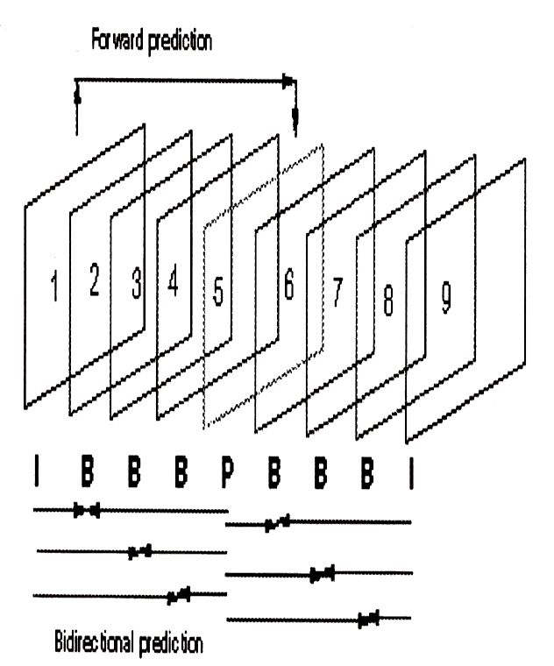
Example of MPEG Stream
B frames 2 3 4 are bi-directionally coded using I frame 1 and P frame 5Pframe 5 must be decoded before B frames 2 3 4
I frame 9 must be decoded before B frames 6 7 8
Frame order for transmission: 1 5 2 3 4 9 6 7 8

Slide 89
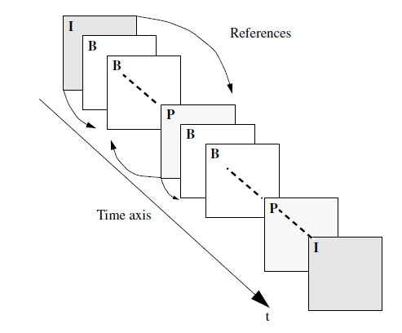
For practical applications, the sequence IBBPBBPBBIBBPBBPBB... has proven to be useful. This permits random access with a resolution of nine still images (i.e., about 330ms) and still provides a very good compression ratio.
Every 15 images includes one I frame.

Slide 90
The following detailed description of image processing, quantization and entropy encoding distinguishes the four image types.
I frame
I frame are encoded by performing a DCT on the 8x8 blocks defined with in the macro block.
The DC coefficients are then DPCM coded and the differences between consecutive blocks of each components are calculated and transformed into variable length code words.
Ac coefficients are run length encoded and then transformed into variable length code word.

Slide 91
P Frames
In consecutive images, some areas of the images often shift(move), but do not change.
To encode a block, the most similar macro block in the preceding image must be determined.
Most similar block: Differences between the absolute values of the luminance component for each macro block in the preceding image. The macro block with the lowest sum of differences is the most similar.
For each block motion vector is generated. Only the motion vector (the spatial difference between the two macro blocks) and the small difference between the macro blocks need to be encoded.
The coder essentially decides whether to code a macro block predictively or like an I frame and whether it should be coded with a motion vector.

Slide 92
In coding P-frame-specific macro blocks, differences between macro blocks as well as the motion vector need to be considered.
The difference values between all six 8×8 pixel blocks of a macro block being coded and the best matching macro block are transformed using a two-dimensional DCT.
Further data reduction is achieved by inserting a six-bit value into the encoded data stream. Otherwise, the DC- and AC-coefficients are then encoded using the same technique.
Next, run-length encoding is applied and a variable length coding is determined according to an algorithm similar to Huffman.
Since motion vectors of adjacent macro blocks often differ only slightly, they are DPCM coded.
The result is again transformed using a table; a subsequent calculation performs a transformation into variable-length coded words.

Slide 93
B Frames
In addition to the previous P or I frame, B-frame prediction takes into account the following P or I frame.
Macro blocks can be derived from macro blocks of previous and following p and/or I frame.
A prediction can be interpolate two similar macro blocks. In this case, two motion vector are encoded and one difference block is determined b/n the macro blocks to be encoded and the interpolated macro block.
Subsequent quantization and entropy encoding are performed as for P-frame specific macro block.
Since B frame cannot serve as reference frames for subsequent decoding, they need not be stored in the decoder.

Slide 94
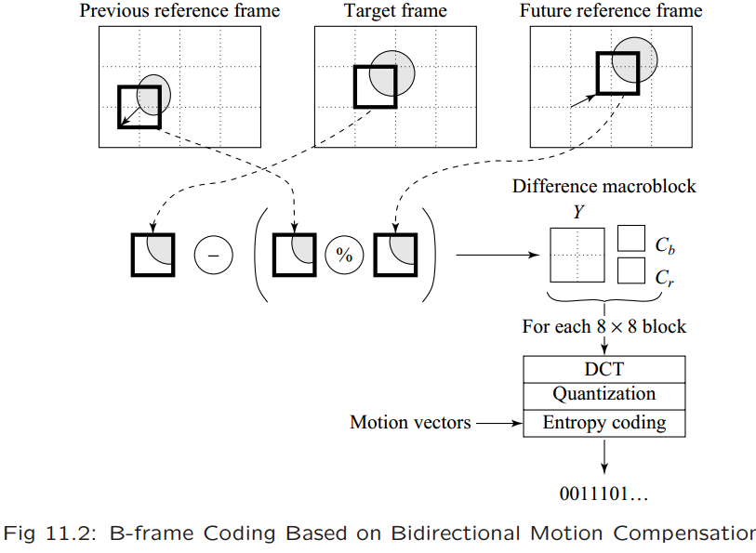

Slide 95
D Frames
D frames contain only the low-frequency components of an image.
A D-frame always consists of one type of macro block and only the DC-coefficients of the DCT are coded.
D frames are used for fast-forward display. This could also be realized by a suitable placement of I frames. For fast-forward, I frames must appear periodically in the data stream.
In MPEG, slow-rewind playback requires considerable storage. All images in a so-called group of pictures must decoded forwards and stored before they can be displayed in reverse.

Slide 96
Quantization
Concerning quantization, it should be noted that AC-coefficients of B and P frames are usually very large values, where as those of I frames are very small.
MPEG quantization adjusts itself accordingly.
If the data rate increases too much quantization becomes more coarse.
If the data rate falls, then quantization is performed with finer granularity.

Slide 97
Audio Coding
The most important criterion is the choice of sample rate of 44.1kHz or 48kHz (additionally 32kHz) at 16bits per sample value. Each audio signal is compressed to either 64, 96, 128, or 192Kbit/s.
Three quality levels (layers) are defined with different encoding and decoding complexity.
A transformation into the frequency domain is applied for audio uses Fast Fourier Transformation(FFT).
The relevant portion of the spectrum is divided into 32 nonoverlapping subbands. The audio signal is thus split into 32 subbands.
Different components of the spectrum can then be quantized differently.
In parallel with the actual FFT, the noise level in each subband is determined using a psychoacoustic model.

Slide 98
At a higher noise level, a coarser quantization is performed. A lower noise level results in finer quantization.
In the first and second layers, the appropriately quantized spectral components are simply PCM-encoded. The third layer additionally performs Huffman coding.
Each layer defines 14 fixed bit rates for the coded audio data stream, which in MPEG are addressed by a bit rate index.

Slide 99
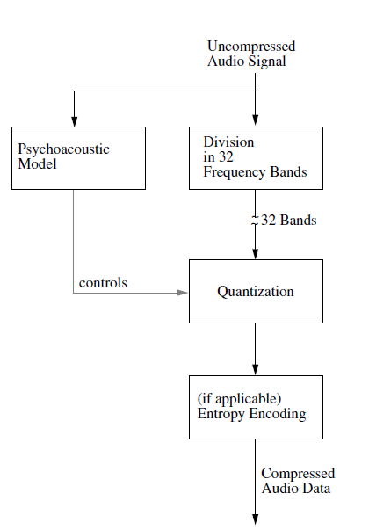
Figure . MPEG audio encoding.

Slide 100
Data Stream
Like JPEG, MPEG specifies a precise syntax for the compressed audio and video data streams.
Audio Stream
An audio stream is comprised of frames, which are made up of audio access units, which in turn are divided into slots.
At the lowest coding complexity (layer 1), a slot consists of 4 bytes; otherwise it is one byte.
Frames consist of a fixed number of samples.
An audio access unit is the smallest compressed audio sequence that can be completely decoded independently of all other data.
At 48kHz, the audio access units contained in a frame have a play time of 8 ms; at 44.1kHz, the play time is 8.7ms; and at 32kHz, the play time is 12ms.
In the case of stereo, data from both channels are included in one frame.

Slide 101
Video Stream
A video stream is comprised of 6 layers:
1. At the highest level, the sequence layer, data buffering is handled.
The beginning of the sequence layer thus includes two entries: the constant bit rate of the sequence and the minimum storage capacity required during decoding.
A video buffer verifier is added after the quantizer that uses the bit rate resulting from decoding in order to monitor the decoding delay.
The video buffer verifier influences the quantizer and forms a type of control loop.
Successive sequences can have varying bit rates.
2. The group of pictures layer contains at least an I frame, which must be one of the first images.

Slide 102
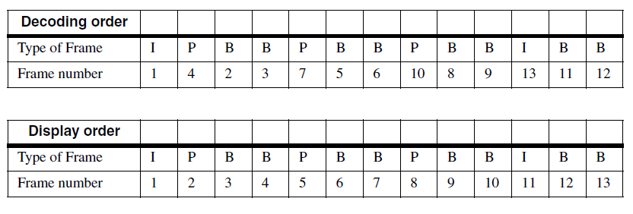
Random access to this image is always possible.
It is possible to distinguish between the order of images in the data stream and their display order.
The data stream must always begin with an I frame so that the decoder can first decode and store the reference image.

Slide 103
3. The picture layer contains a whole still image.
The image’s temporal reference is defined using an image number.
There are also data fields defined in this layer that are not yet used in MPEG. These fields are reserved for future extensions and may not be used by the decoder.
4. Slice layer : Each slice consists of macro blocks, the number of which can vary from image to image.
A slice also includes the scaling used for DCT quantization of all its macro blocks.
5. Macro block layer: A macro block is formed of six blocks of 8×8 pixels, ordered as follows: first four blocks for the luminance component then the two chrominance blocks.
6. The lowest layer is the block layer.

Slide 104
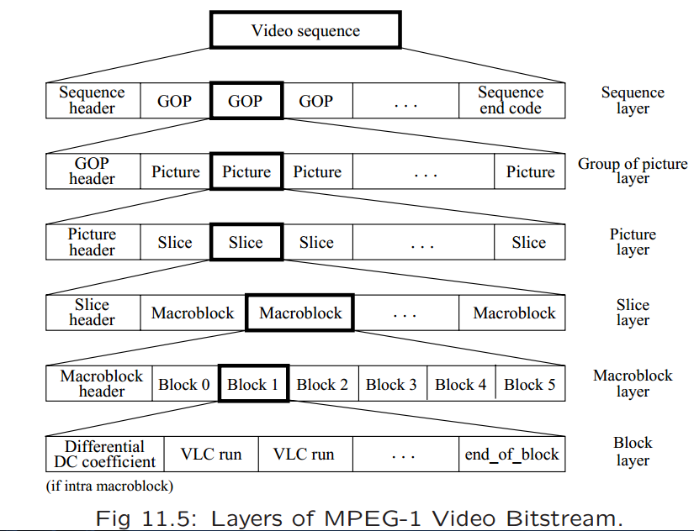

Slide 105
System Definition
The MPEG system definition also specifies the combination of both data streams into a single stream.
The most important task of this process is the actual multiplexing.
It includes the coordination of input data streams with output data streams, clock adjustment, and buffer management.
Data streams as defined by ISO 11172 are divided into separate packs. The decoder gets the information it needs from the multiplexed data stream.
For example, the maximal data rate is included at the beginning of every ISO 11172 data stream in the first pack.

Slide 106
MPEG-2
MPEG standard at the maximum data rate of about 1.5Mbit/s.
Video compression technique at the maximum data rates up to 100Mbit/s is known as “MPEG-2”, which aims at a higher image resolution.
MPEG-2 Video standard specifies the coded bit stream for higher quality digital video.
As a compatible extension, MPEG-2 video builds on the MPEG-1 standard by supporting interlaced video formats and a number of other advanced features, including support for HDTV.
MPEG-2 Video was defined in terms of extensible profiles, each of which supports the features needed by a class of applications.
MPEG-2 video supports a wide range of applications from mobile to high quality HD editing. For many applications, it is unrealistic and too expensive to support the entire standard. To allow such applications to support only subsets of it, the standard defines profile and level.
The profile defines the subset of features such as compression algorithm, chroma format, etc. The level defines the subset of quantitative capabilities such as maximum bit rate, maximum frame size, etc.

Slide 107
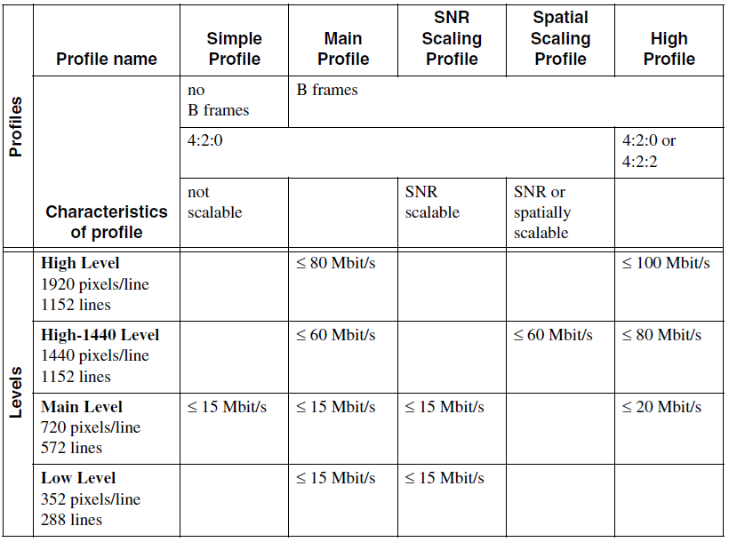

Slide 108
The MPEG-2 Main Profile was defined to support digital video transmission in the range of about 2 to 80Mbit/s using cable, satellite, or other broadcast channels, as well as to support digital storage and other communications applications.
The MPEG experts also extended the features of the Main Profile by defining a hierarchical/scalable profile. This profile aims to support applications such as compatible terrestrial TV, packet-network video systems, backwards compatibility with existing standards (MPEG-1 and H.261), and other applications requiring multi-level coding.
For example, such a system could offer a consumer the option of using a small portable receiver to decode standard definition TV from a broadcast signal, or using a larger fixed receiver to decode HDTV from the same signal.

Slide 109
Scaling may act on various parameters:
Spatial scaling facilitates decompression of image sequences with different horizontal and vertical resolutions.
Scaling the data rate allows for playback at different frame rates.
Amplitude scaling can be interpreted as affecting either the pixel depth or the resolution at which DCT-coefficients are quantized. This then leads to a layered coding and to the possibility of progressive image presentation, which is not relevant for video data.

Slide 110
Scaling is one of the most important MPEG-2 extensions to MPEG-1.
MPEG-2 minimizes the effects of the loss of individual ATM cells in an MPEG-2 coded data stream.
Sequences of different frame types (I, P, B) should be defined to minimize end-to-end delay at a given data rate.
The MPEG-2 group developed the MPEG-2 Audio Standard for low bit rate coding of multichannel audio.
MPEG-2 supplies up to five full bandwidth channels (left, right, centre, and two surround channels), plus an additional low-frequency enhancement channel and/or up to seven commentary/multilingual channels.
The MPEG-2 Audio Standard also extends MPEG-1 coding of stereo and mono channels with half sampling rates (16kHz, 22.05kHz, and 24kHz), which significantly improves quality at 64Kbit/s or less per channel.

Slide 112
MPEG-2 System
MPEG-2 addresses video together with associated audio.
MPEG-2 defines how an MPEG-2 system can combine audio, video, and other data in a single stream, or in multiple streams, suitable for storage and transmission.
MPEG-2 imposes syntactic and semantic rules that are necessary and sufficient to synchronize the decoding and presentation of video and audio information, while ensuring that the decoder’s coded data buffers do not overflow or run out of data.
The streams include time stamps used in the decoding, presentation, and delivery of the data.
In the first step, the basic multiplexing approach adds system-level information to each stream.
Each stream is then divided into packets, forming a Packetized Elementary Stream (PES).

Slide 113
Next, the PESs are combined into a Program Stream or a Transport Stream.
Both streams were developed to support a large number of known or anticipated applications.
The Program Stream resembles the MPEG-1 stream, but should only be used in a relatively error-free environment. Program stream packets are of variable length. Timing information in this stream can be used to implement a constant end-to-end delay (along the path from the input of the coder to the output of the decoder).Example: Digital storage medias like DVD, CD-ROM etc
The Transport Stream bundles the PESs and one or more independent time bases into a single stream. This stream was developed for use with lossy or noisy media. Each packet has a length of 188 bytes, including a four-byte header. The Transport Stream is well-suited for transmission of digital television and video telephony over fibre, satellite, cable, ISDN, ATM, and other networks, as well as for storage on digital video tape and other devices. Example: broadcasting, telecommunications(ATM).
A conversion between the Program Stream and the Transport Stream is possible and sensible.

Slide 114
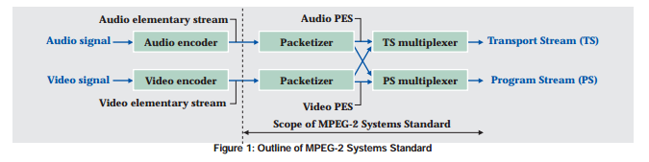

Slide 115
MPEG-4
A newer standard. Besides compression, pays great attention to issues about user interactivities.
Work on another MPEG initiative for very low bit rate coding of audio visual programs started in September 1993 in the ISO/IEC JTC1. Formally designated ISO/IEC 14496, MPEG-4 was published in November 1998 and adopted as an international standard in January 1999.
MPEG-4 incorporates new algorithmic techniques, such as model-based image coding of human interaction with multimedia environments and low bit-rate speech coding for use in environments like the European Mobile Telephony System (GSM).
Main objectives of MPEG-4 are
-content based interactivity.
-Integration.
-Flexibility and extendibility.

Slide 116
Content based Interactivity.
MPEG-4 places a strong emphasis on interactivity.
MPEG-4 integrates a large number of audiovisual data types, for example natural and synthetic,
MPEG-4 thus allows the design of audiovisual systems that are oriented around specific users yet are compatible with other systems.
It provides for a universal coding of various forms of audiovisual data, called audiovisual objects.
Random access to audio and video scenes as well as the ability to revise content are supported.
Scene is represented as a collection of a few or many independent audiovisual objects.
The user can play with the contents of the scene, for example by changing the properties of some objects (e.g., position, motion, texture, or form), accessing only selected parts of a scene, or even using cut and paste to insert objects from one scene into another scene.

Slide 117
Integration
MPEG-4 attempts to smoothly integrate natural and synthetic audiovisual objects, for example mono, stereo, and multiple channel audio.
MPEG-4 supports either 2-D or 3-D (mono or stereo, respectively) video modes, as well as these from additional camera perspectives (so-called multi view video).
This integration should be extended with regard to audiovisual interrelationships so that processing can incorporate the mutual influence and dependence between different types of information.
New and already available analysis and coding tools are being integrated into MPEG-4.

Slide 118
Flexibility and extendibility.
Developers can use the compression method in different ways and configure systems to support a multitude of applications.
MPEG-4 is thus not a fixed standard suitable only for a few applications.
MPEG-4 provides flexibility and extensibility through the “MPEG-4 Syntactic Description Language (MSDL).”
MPEG-4 standard can always incorporate new tools, algorithms, and concepts in MSDL to support new or improved functionalities.
The areas of telecommunications, computers, and television/film are converging and are in the position of being able to exchange elements that previously were typical for only one of the three areas.

Slide 119
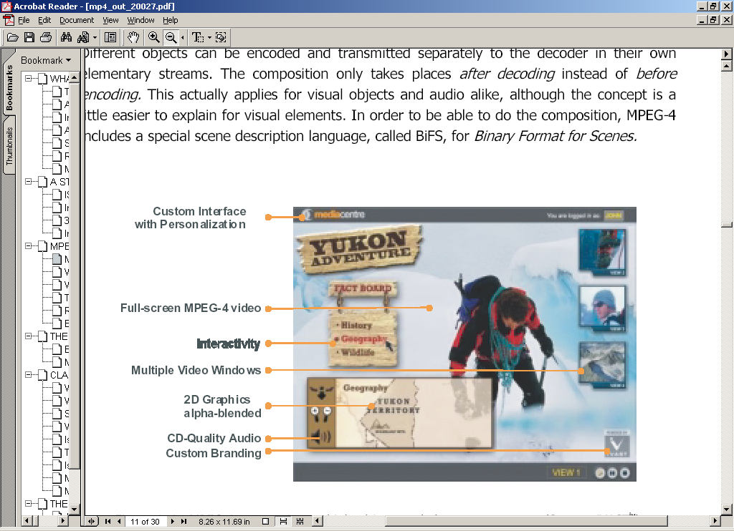

Slide 120
MPEG-4 Extensions Compared with MPEG-2
New or improved functionalities.
MPEG-4 must additionally provide some other important so-called standard functions included in previously available standards.
MPEG-4 makes it possible to scale content, spatial and temporal resolution, quality, and complexity with finer granularity. This content-based scalability implies the existence of a priority mechanism for a scene’s objects.
MPEG-4 incorporates a syntax and various coding methods to support content based manipulation and bit stream editing, without requiring transcoding (conversion from one coding system to another). This means that the user should be able to access a specific object within a scene or bit stream, thus making it possible to easily change the object’s properties.

Slide 121
MPEG-4 offers efficient, content-based tools to access and organize multimedia data. These features include indexing, addition of hyperlinks, queries, viewing data, uploading or downloading data, and deleting data.
MPEG-4 supports efficient methods of combining synthetic and natural scenes (e.g., text and graphics overlays).
MPEG-4 supports scenes with different views/sound tracks and can efficiently code them together with sufficient information to synchronize the resulting basic streams.
MPEG-4 is thus needed in order to provide substantially better audiovisual quality than either existing standards or standards under development (e.g. H.263), at comparably low bit rates.
It provide sufficient robustness against serious errors. for example, selective forward error correction, error containment, or error concealment.
MPEG-4 incorporates efficient methods to improve temporal random access to parts of an audiovisual sequence in a limited time interval with fine resolution.

Slide 122
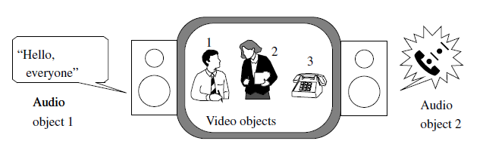
Audiovisual Objects (AVOs) in MPEG-4
Audiovisual scenes in MPEG-4 are composed of audiovisual objects (AVOs), which are organized in a hierarchical fashion.
Primitive AVOs are found at the lowest level of the hierarchy. Examples are:
-a two-dimensional fixed background,
-the image of a talking person (without background) or
-the speech associated with the person.
Example of an audiovisual scene in MPEG-4

Slide 123
MPEG-4 standardizes a number of these primitive AVOs that can be used to represent natural as well as synthetic types of content, which can be either two- or three dimensional.
AVOs are individually coded in order to achieve maximum efficiency. They can be represented independently of other AVOs or of the background information.
MPEG is working with representatives of organizations that manage electronic media rights on defining a syntax for storing information about Intellectual Property Rights (IPR) pertaining to MPEG-4 AVOs and on developing tools to support IPR identification and IPR protection.
The MPEG-4 standard thus incorporates support for unambiguous identification using attributes assigned by international naming authorities.
These can be used to identify the current holder of the rights to an AVO

Slide 124
Combining AVOs into Scenes
AVOs are combined in a hierarchical fashion to make audiovisual scenes.
The result is a dynamic, tree-like structure of AVOs that can be changed through user interaction.
Coding of Visual Objects
Three fundamental video coding extensions, in MPEG-4 are
Object-based scene layering and separate coding and decoding of layers.
Shape-adaptive DCT coding.
Object-based tool box for motion prediction

Slide 125

Object-based scene layering and separate coding and decoding of layers
Divide the scene into layers that represent its physical objects.
Each object is then coded separately and transmitted over its respective bit stream layer.

Slide 126
Advantage: Each bit stream layer can be independently processed and separately coded and decoded. This achieves efficient coding and permits content-based functionalities.
If transmission takes place in environments susceptible to errors, different layers can be treated differently.
Shape-adaptive DCT coding
After a scene has been successfully segmented, creating the different object layers, each layer is coded separately. This is done using a SA-DCT[Shape Adaptive-DCT] coding technique that adapts itself to the object’s shape.
Shape-adaptive DCT allows transformation coding of image blocks of any shape.
For each object layer, the object shape information is transmitted first.

Slide 127
This is followed by the blocks’ motion vectors and the DCT coefficients corresponding to the motion and to the object’s texture information as described by luminance and chrominance.
In order to permit separate decoding of each object layer, the coding uses no information about shape, motion, or texture outside of the respective layer.
Input images to be encoded are split into grids of macro blocks and blocks. A block motion vector is transmitted for each macro block.
Object-based tool box for motion prediction

Slide 128
Streams in the MPEG-4 Standard
MPEG-4 divides content into multiple objects, the stream properties affect multiplexing, demultiplexing, and synchronization of multiple streams.
AVO data is bundled into one or more Elementary Streams.
These are characterized by the Quality of Service (QoS) needed for transmission (e.g., maximum bit rate or bit error rate) as well as other parameters, for example, stream type information, which helps determine the resources required in the decoder and the precision of time information in the coder.
Stream characteristics is transported from the source to the sink in a synchronized fashion over networks having different QoS is specified in terms of an Access Unit Layer and conceptual two layer multiplexer.

Slide 129
The Access Unit Layer allows Access Units to be identified within Elementary Streams, for example, video or audio frames, and scene description commands, reestablishment of the time base of an AV-object or of a scene description as well as synchronization between them.
The FlexMux Layer (Fle xible Multiplex) comprises a multiplexing tool that allows Elementary Streams (ESs) to be grouped with minimal multiplexing overhead.
The TransMux Layer (Transport Multiplexing) models the layer that provides the transport services that match the required QoS.
In the TransMux Layer, Only interface is specified.Layer can be any network e.g. RTP/UDP/IP, AAL5/ATM

Slide 130


Slide 131
MPEG-7
MPEG-7 ISO Working Group was to establish a metadata standard.
The use of metadata aims at a new type of extension to the coding of multimedia data: mainly improved searching techniques and display strategies, but also consistency checking and, for example, scaling that incorporates consistency and priority.
MPEG-7 calls for the integration and extension of other media content formats (especially MPEG-4) in this way.
In addition to the coding of metadata, MPEG-7 will define interfaces (and only the interfaces) for working in tandem with tools for automatic content analysis and search engines, but not these services themselves.

Slide 132
MPEG-4 Example
ISO N3536 MPEG4

Slide 133

MPEG-4 Example
Daras, P. MPEG-4 Authoring Tool, J. Applied Signal Processing, 9, 1-18, 2003

Slide 134
Fractal Compression
Fractal image and video compression represents an entirely different coding method.
In this technique, no actual pixel information is transmitted, rather only a transformation function that contains an image similar to the target image as a fixed point.
First of all, the decoding process is progressive and the decoding efficiency is scalable, since the quality of the decoded image increases with each iteration step.
Additionally, the process is independent of the resolution. The mapping function can be applied repeatedly in order to get more detail.
The third attribute is an asymmetry between the encoding and decoding processes.
The algorithm makes use of a fractal attribute of images: their self-similarity. Images consist of regions that are similar to one another.

Slide 135
A transformation function then consists of a mapping of each region of an image to the most similar part of the image.
The mapping consists of contracting, stretching, rotating, and skewing the form of the image regions and adjusting their contrast and brightness.
The mapping is achieved in current implementations by dividing the original image into blocks (of 8 × 8 pixels) and, for each block, finding the most similar block of image regions (i.e., overlapping 16 × 16 pixel blocks).
The set of blocks compared with each (8×8) original block is increased by the possible geometric transformations. The most similar block can be found by minimizing a distance measure. Usually the sum of the quadratic pixel differences is minimized.
For natural images, fractal compression can achieve high compression ratios (up to 1000:1) with very good image quality. The biggest disadvantage of this coding method is the complexity of calculation and its low efficacy when applied to graphics images.

Slide 136
Parameter Constraints for levels
Level Max pixels Max lines Max fps
Low 352 288 30
Main 720 576 30
High-1440 1440 1152 60
High 1920 1152 60

Slide 137
Profile
Simple
– no B frames
– only main level
– max bit rate 15 Mbps
Main
– all four levels
– max bitrates 4, 15, 60 and 80 Mbps
– no scalability allowed
SNR Scalable
– supports main and low levels with maxmium bitrates of 4(3) and 15(10) Mbps.
• Spatial Scalable
– only high-1440 level with max bitrate of 60(15)Mbps
• High
– main 20(4), high-1440 80(20), High 100(25)

Slide 138


